Slide 1


Datamining and AI | Proposed Project
PSUT – AI & Datamining Courses
Dr. Rawan Ghenmat & Dr. Nailah Madi SESAME Synchrotron | Machine Failure Prediction Project
Mar 3, 2024
Mustafa Ali Alzubi

Slide 2
Datamining and AI |Topics
Introduction to SESAME Facility
Introduction to the problem
Available resources
Project idea
Similar work done

Slide 3

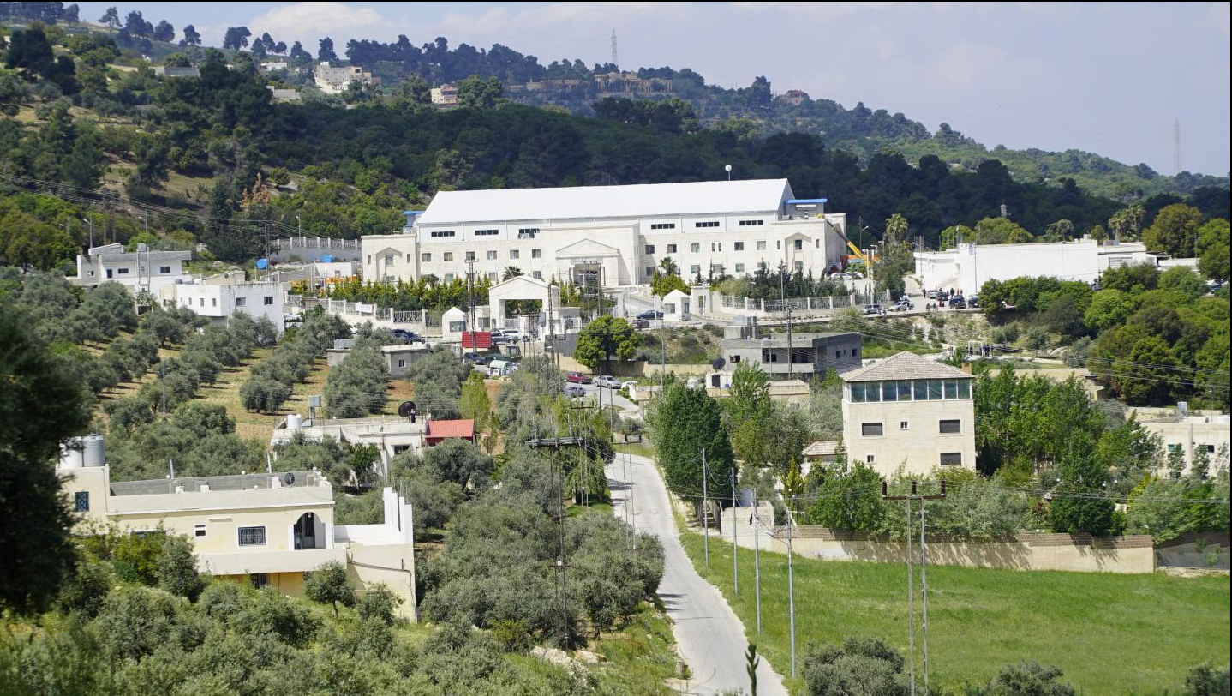


Datamining and AI |What is SESAME?
Located in
Our doors
Jordan
are opened
For scientific collaboration
SESAME: Synchrotron-light for Experimental Science and Applications in the Middle East
A 3rd Generation Light Source that has state-of-the-art infrastructure which designed to enable the scientific research in the region for designated users communities
To the rest
of the world

Slide 4
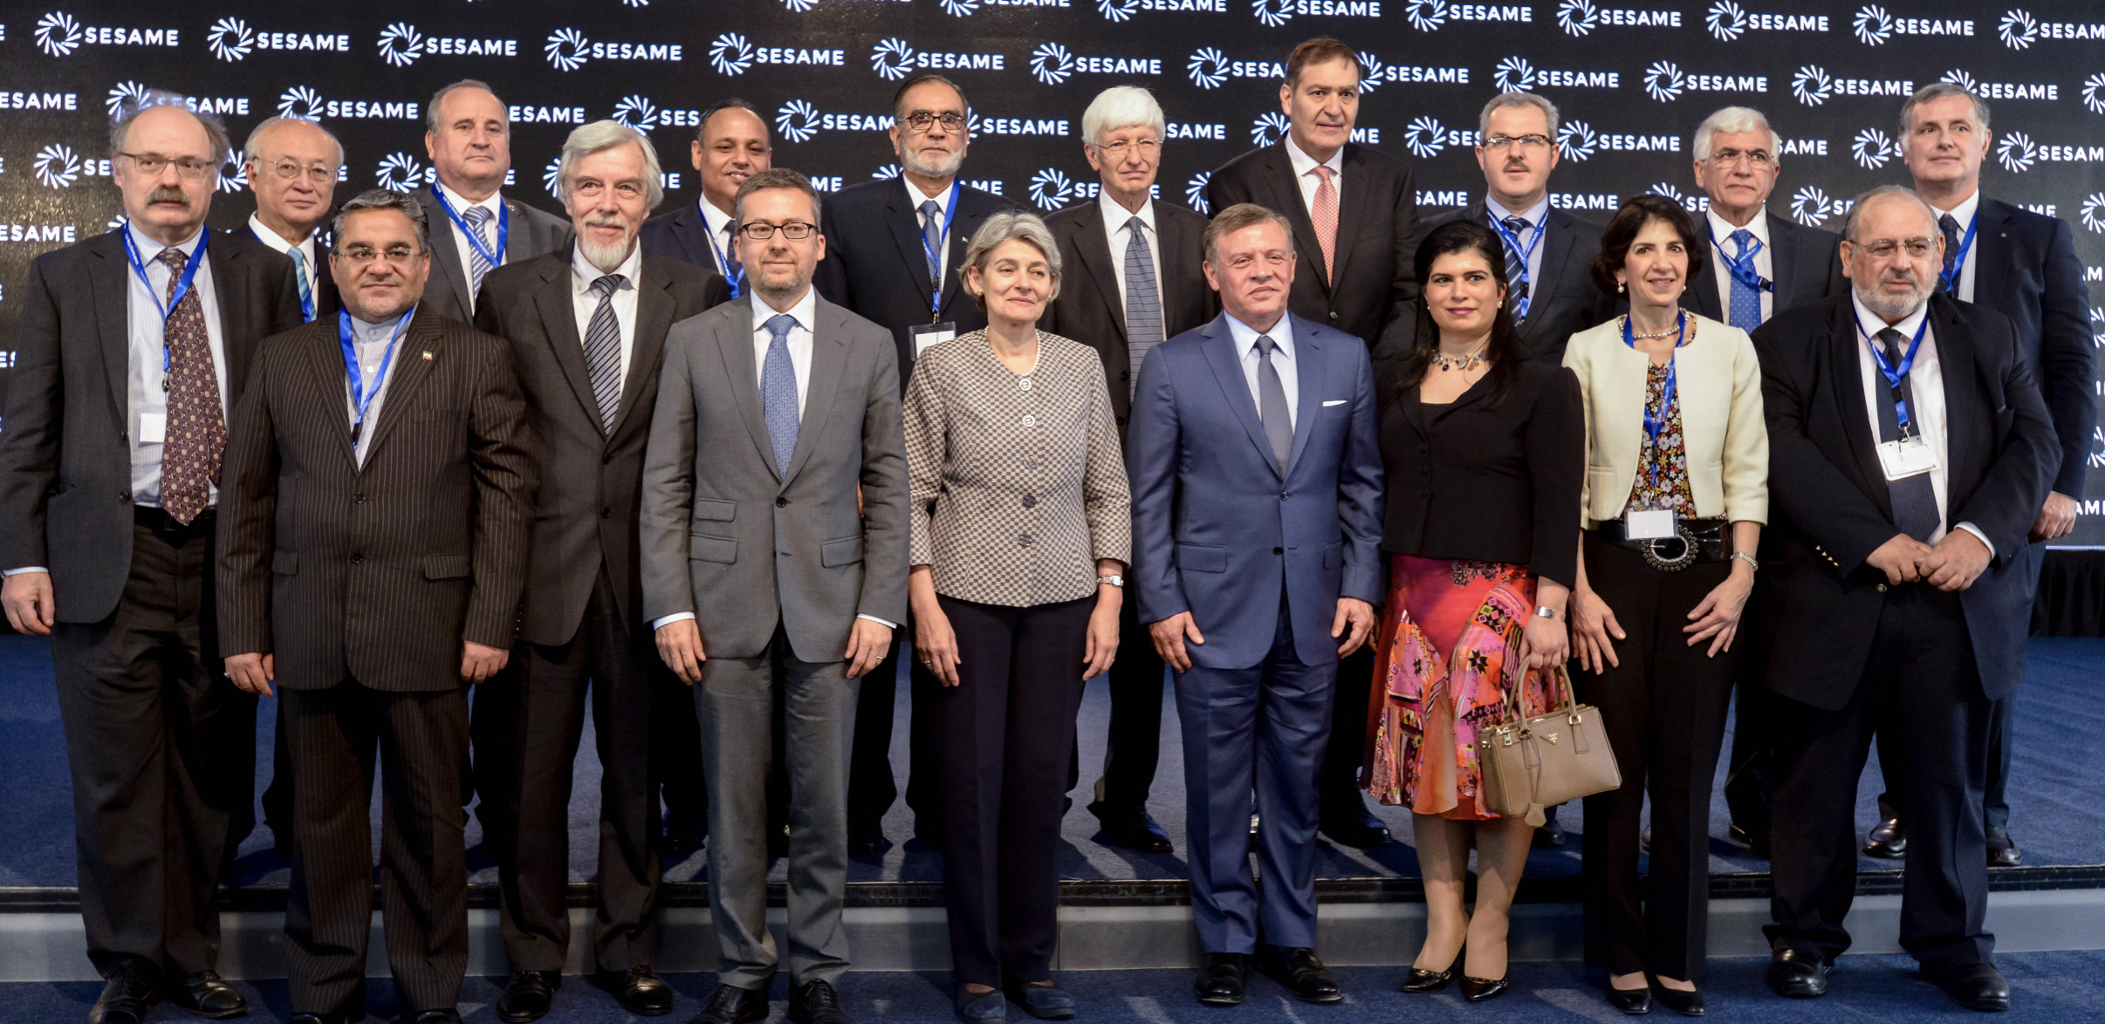
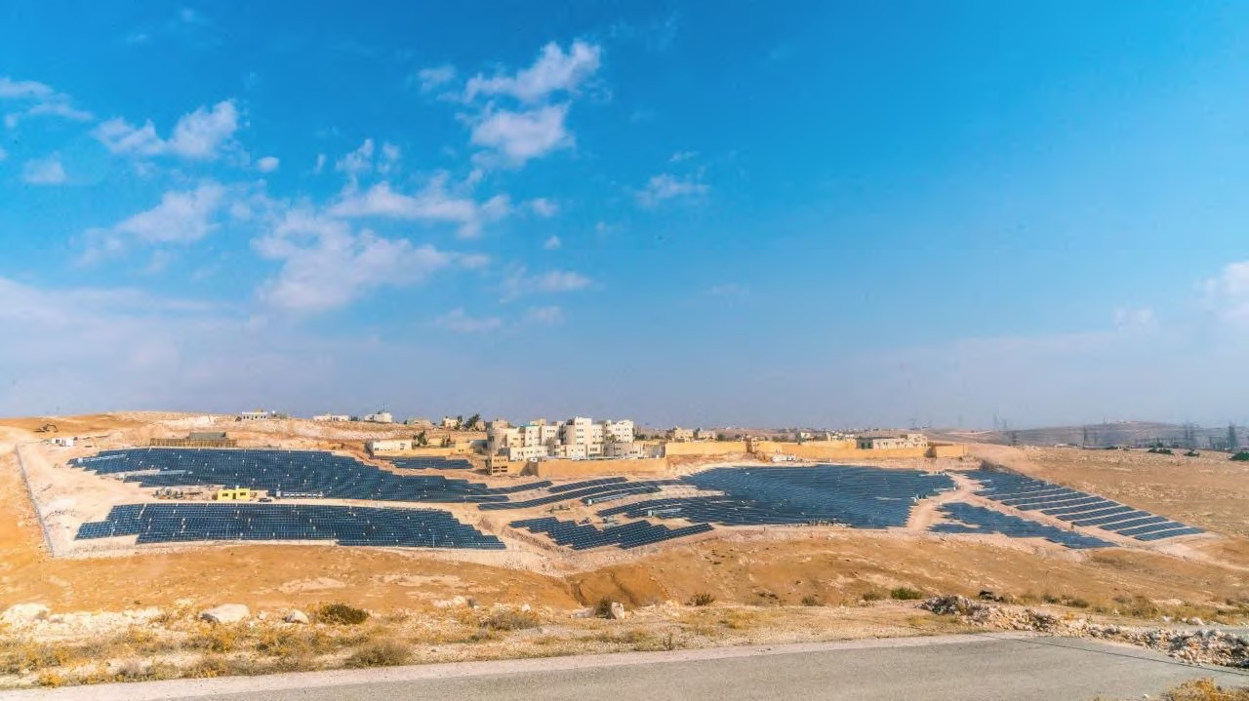
Datamining and AI | SESAME is Unique Research Centre
The first and only synchrotron in MENA
Members & observers countries are 25 -- CERN and EU.
The first and only synchrotron in the world that is powered by green enargy
Excellence centre in the ME
International, multicultural and non-profit organization

Slide 5
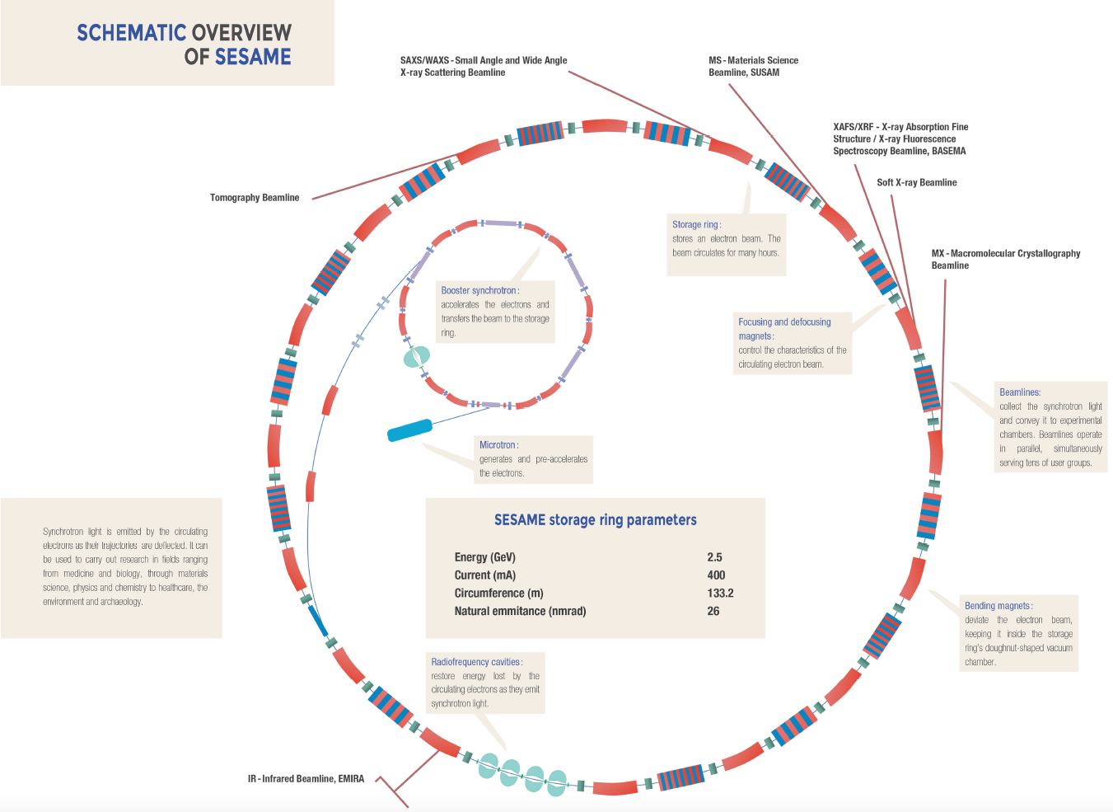
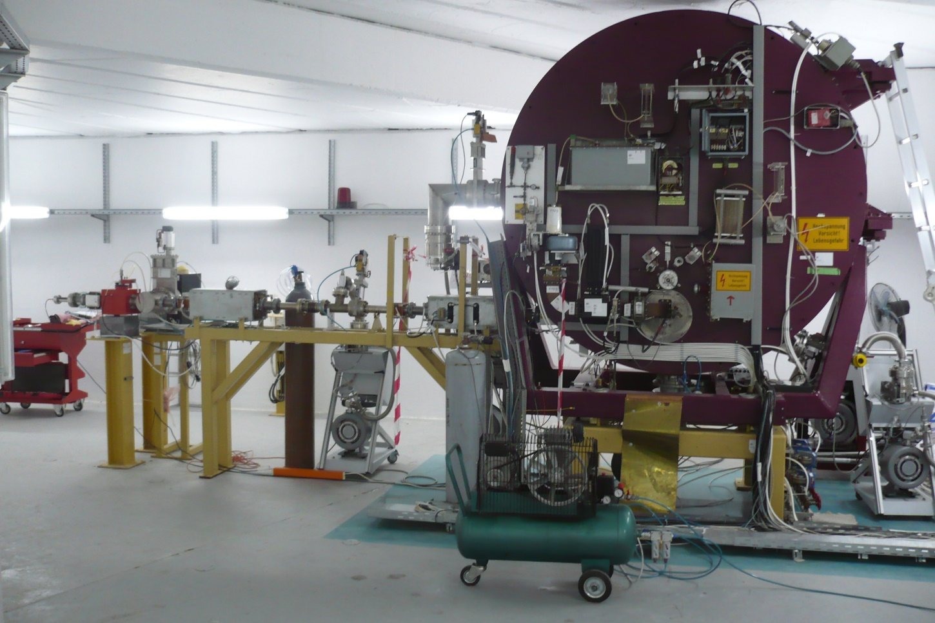
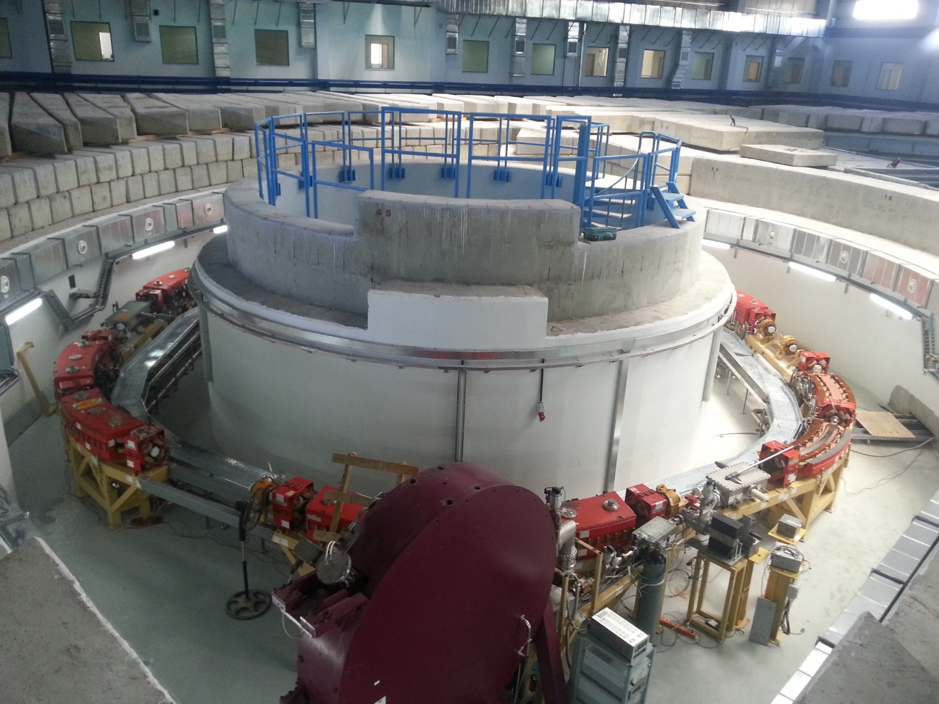
Datamining and AI |How it works ??

Slide 6
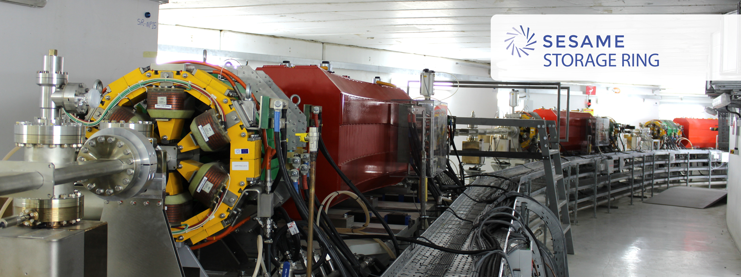
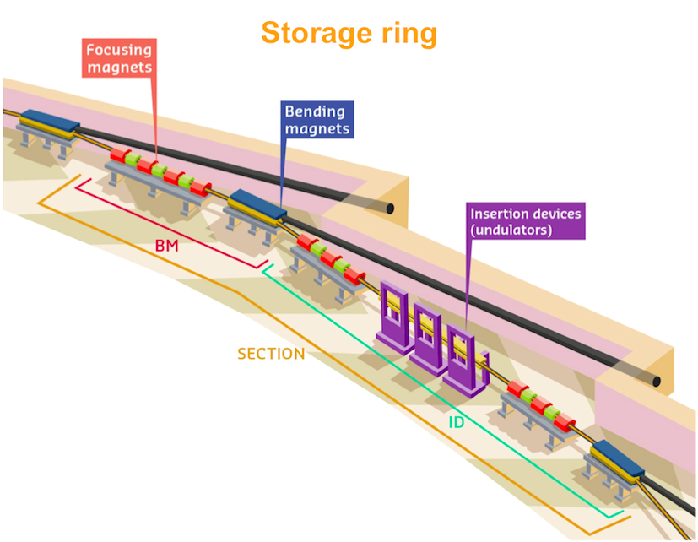
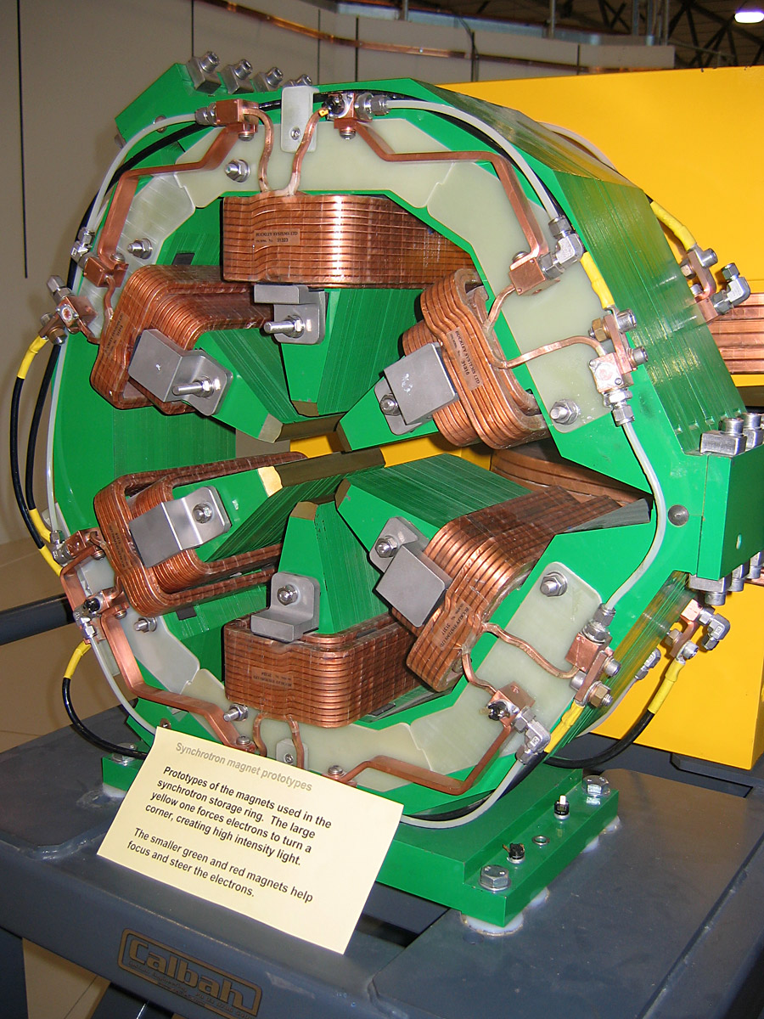
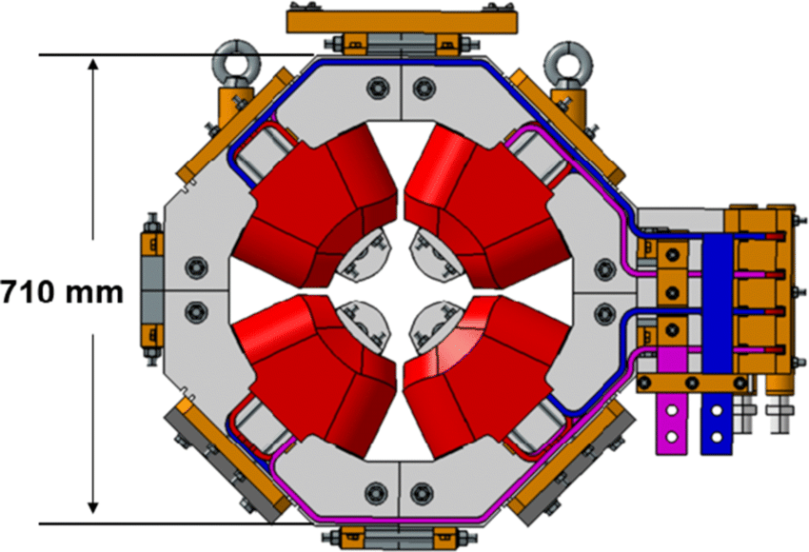
Datamining and AI |How it works??

Slide 7
Datamining and AI |Current and Future Beamlines
No | Beamline | Energy Range | Source Type | Status
BM02 | IR (Infrared) spectromicroscopy | 0.001-3 eV | Bending Magnet | Serving users
BM08 | XAFS/XRF (X-ray Absorption Fine Structure/X-ray Fluorescence) spectroscopy | 4.5-30 keV | Bending Magnet
ID09 | MS (Materials Science) | 5-25 keV | MPW
ID11 L | HESEB: Helmholtz-SESAME Beamline | 70-1800 eV | Undulator | Commissioned
ID10 | BEATS: Beamline for Tomography at SESAME | 8-50 keV | 3-Pole Wiggler | Installation
ID11 R | TXPES: Turkish X-ray Photoemission Spectroscopy | 70-1800 eV | Undulator | Design
 | MX Macromolecular Crystallography | 4 - 14 keV | In-Vacuum Undulator | Planned
 | SAXS (Small Angle X-ray Scattering) | 8 keV | In-Vacuum Undulator

Slide 8


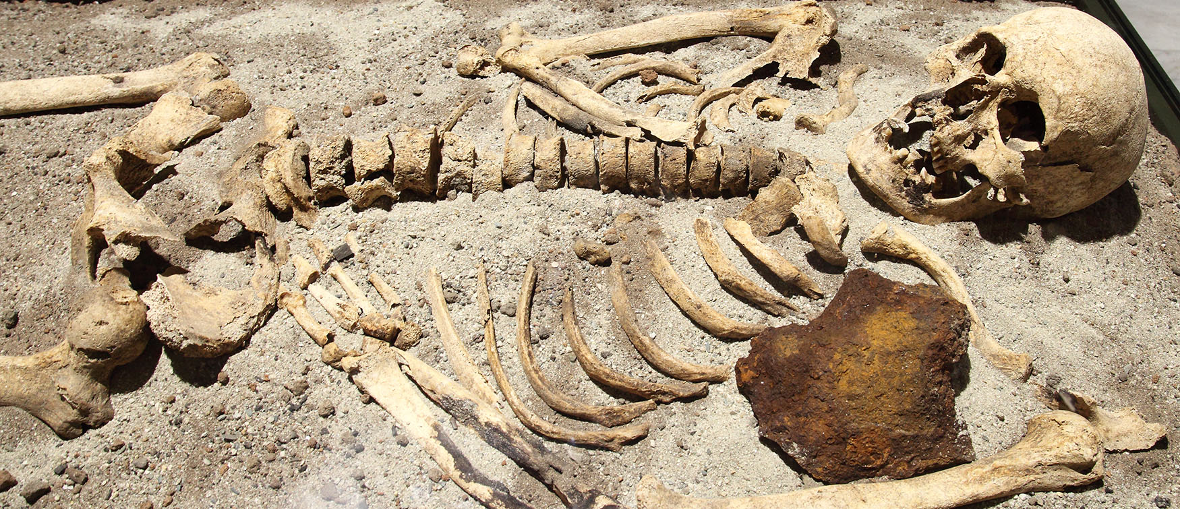

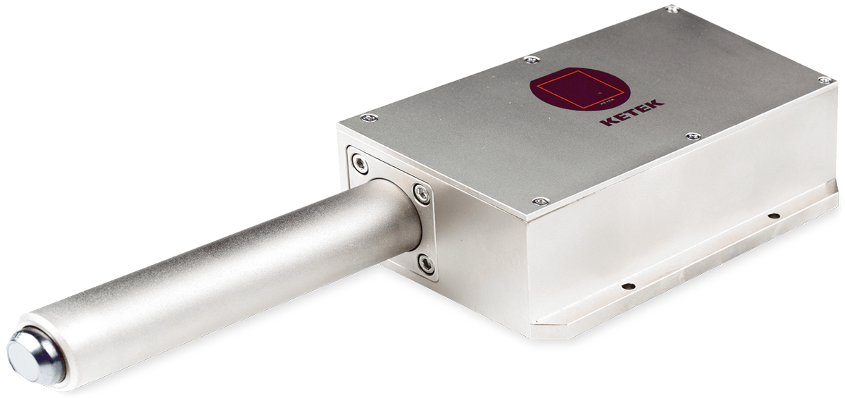
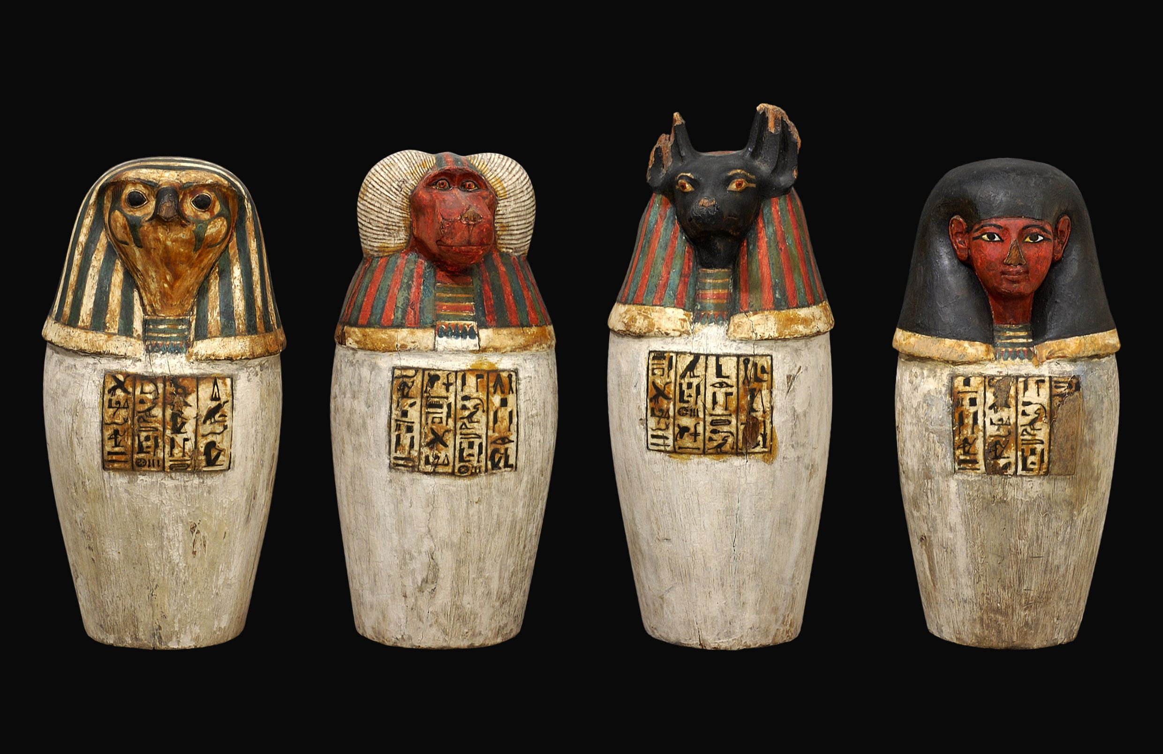
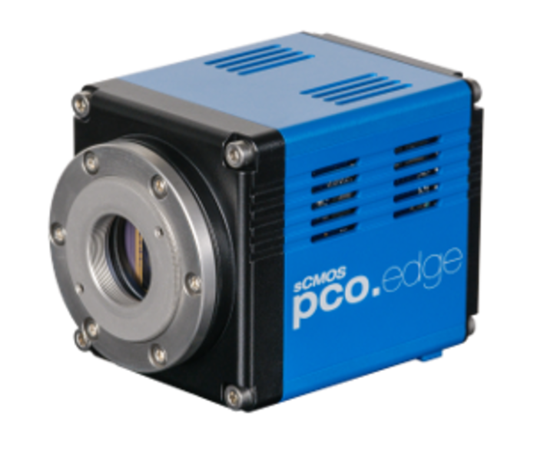
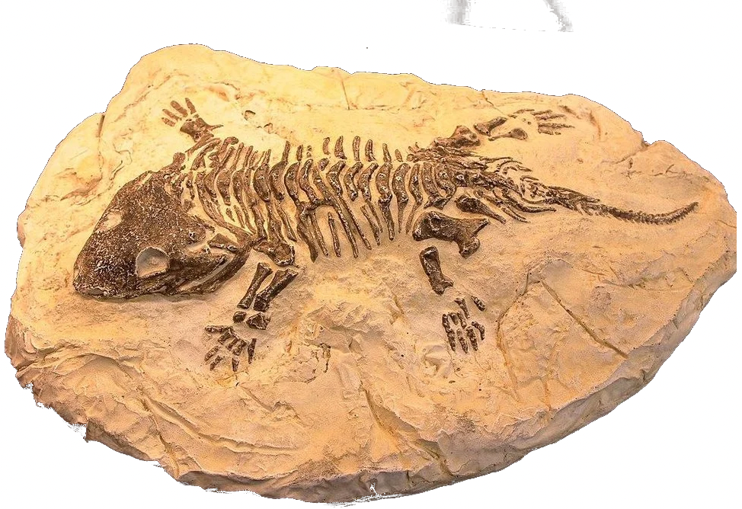
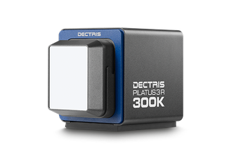


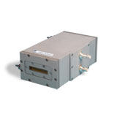

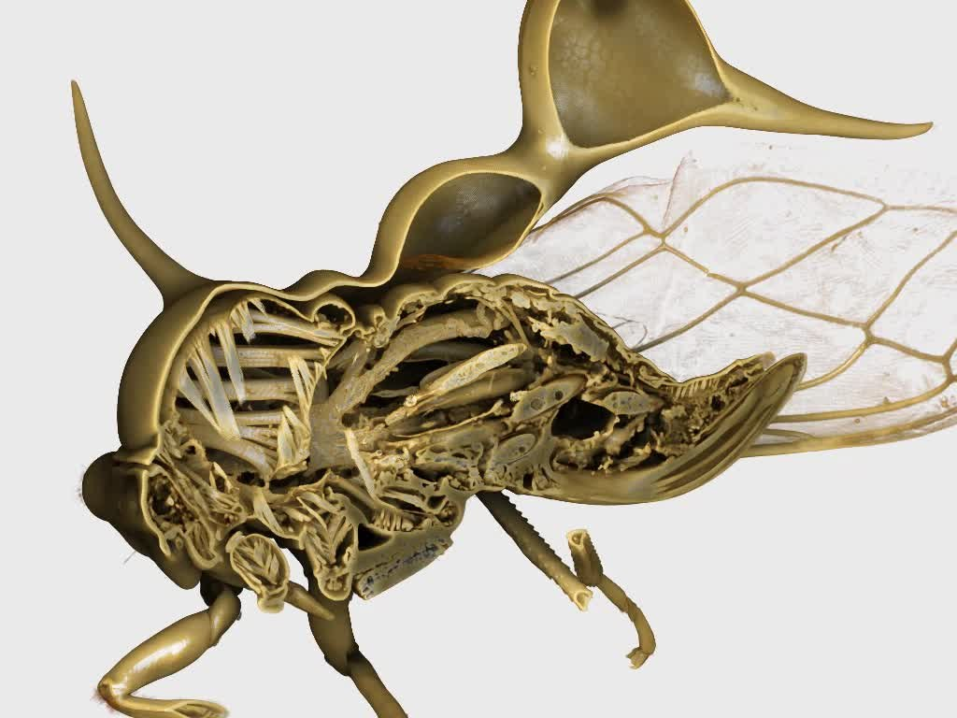
Datamining and AI | Beamlines Applications
Material Science
Human remains
Drugs design
Life science
Cultural heritage
X-ray
Chemical Science
New material
Agriculture
µ-tomography

Slide 9
Datamining and AI |Topics
Introduction to SESAME Facility
Introduction to the problem
Available resources
Project idea
Similar work done

Slide 10
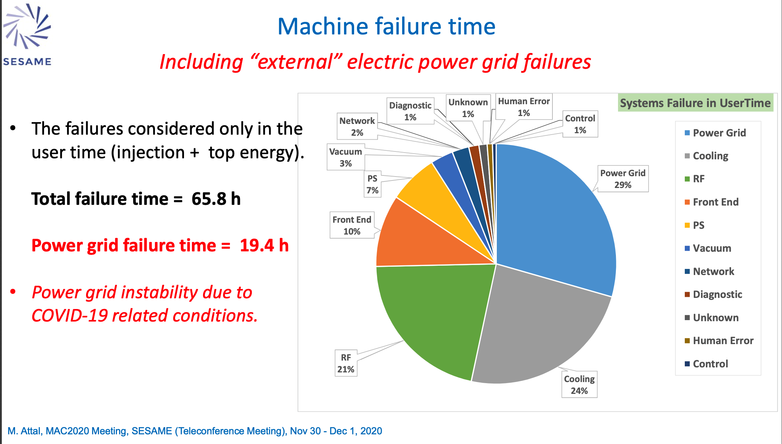
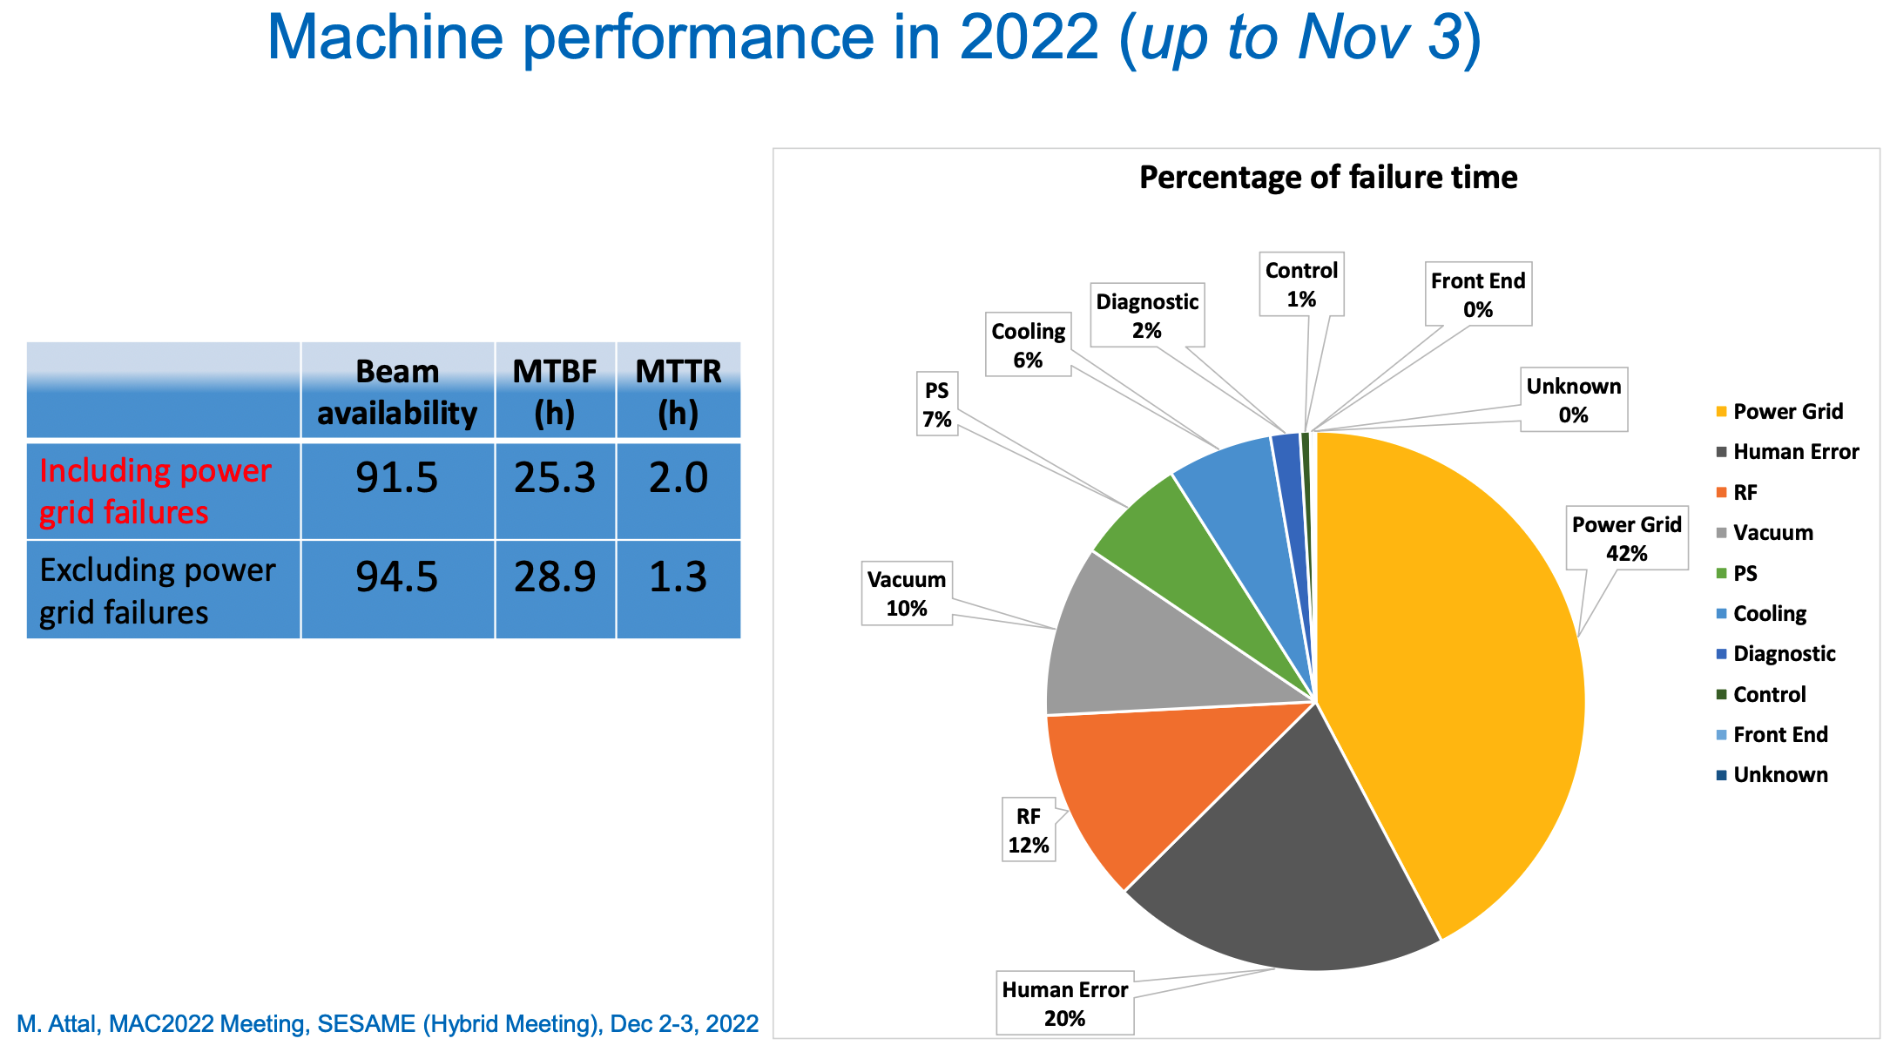
Datamining and AI | Problem Introduction

Slide 11
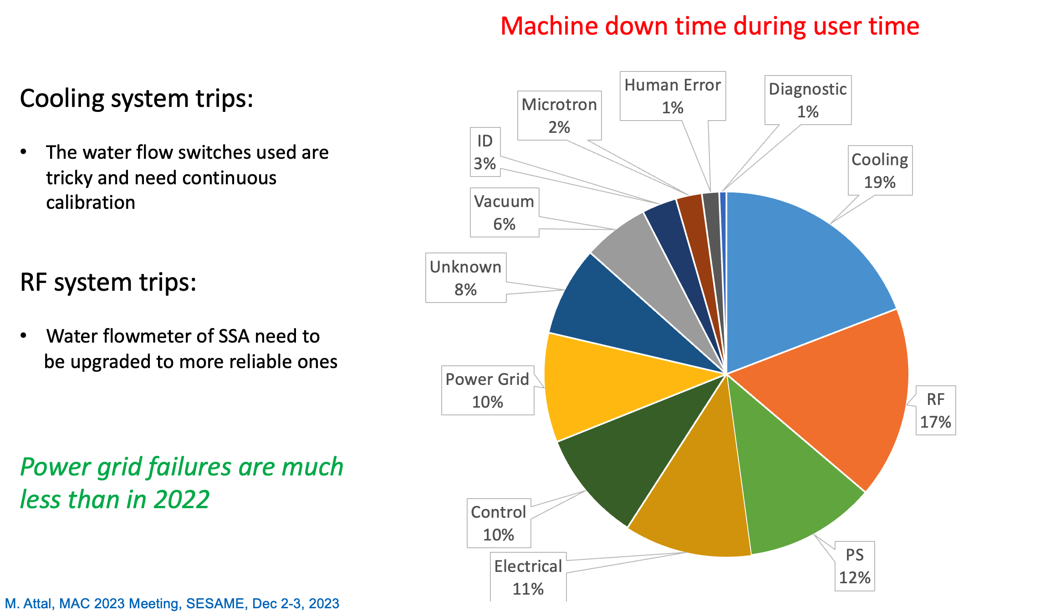
Datamining and AI | Problem Introduction

Slide 12
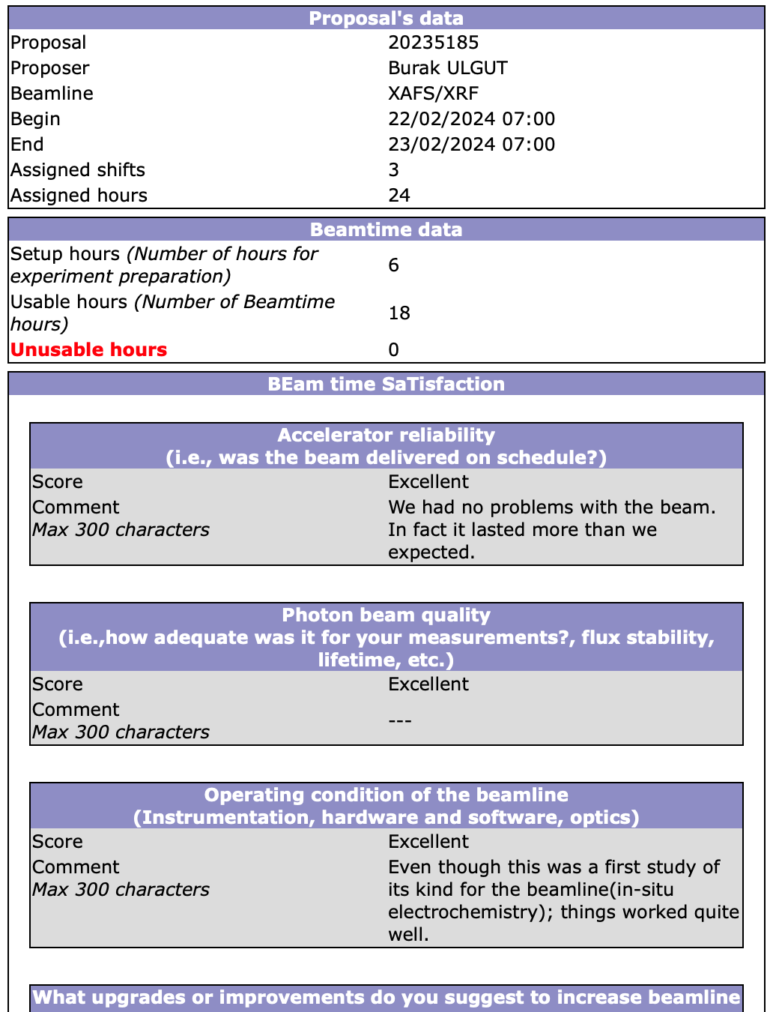
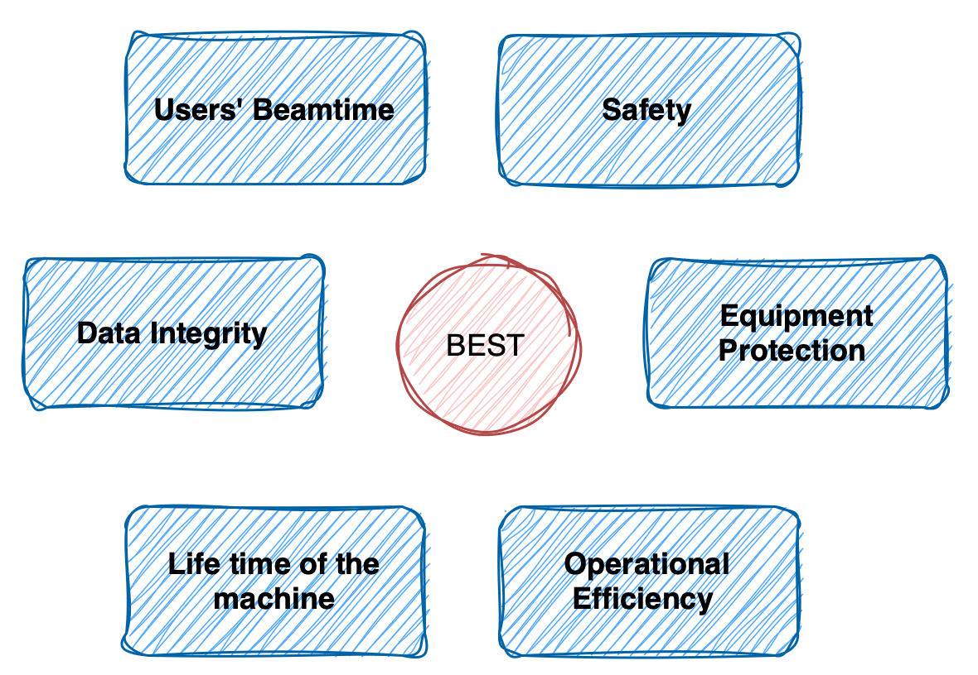
Datamining and AI | Why is it important to minimize failure time ??
BEST: BEame SatisFaction Report … We want to keep our scientist happy. Also we want to keep the machine in safe and good conditions

Slide 13
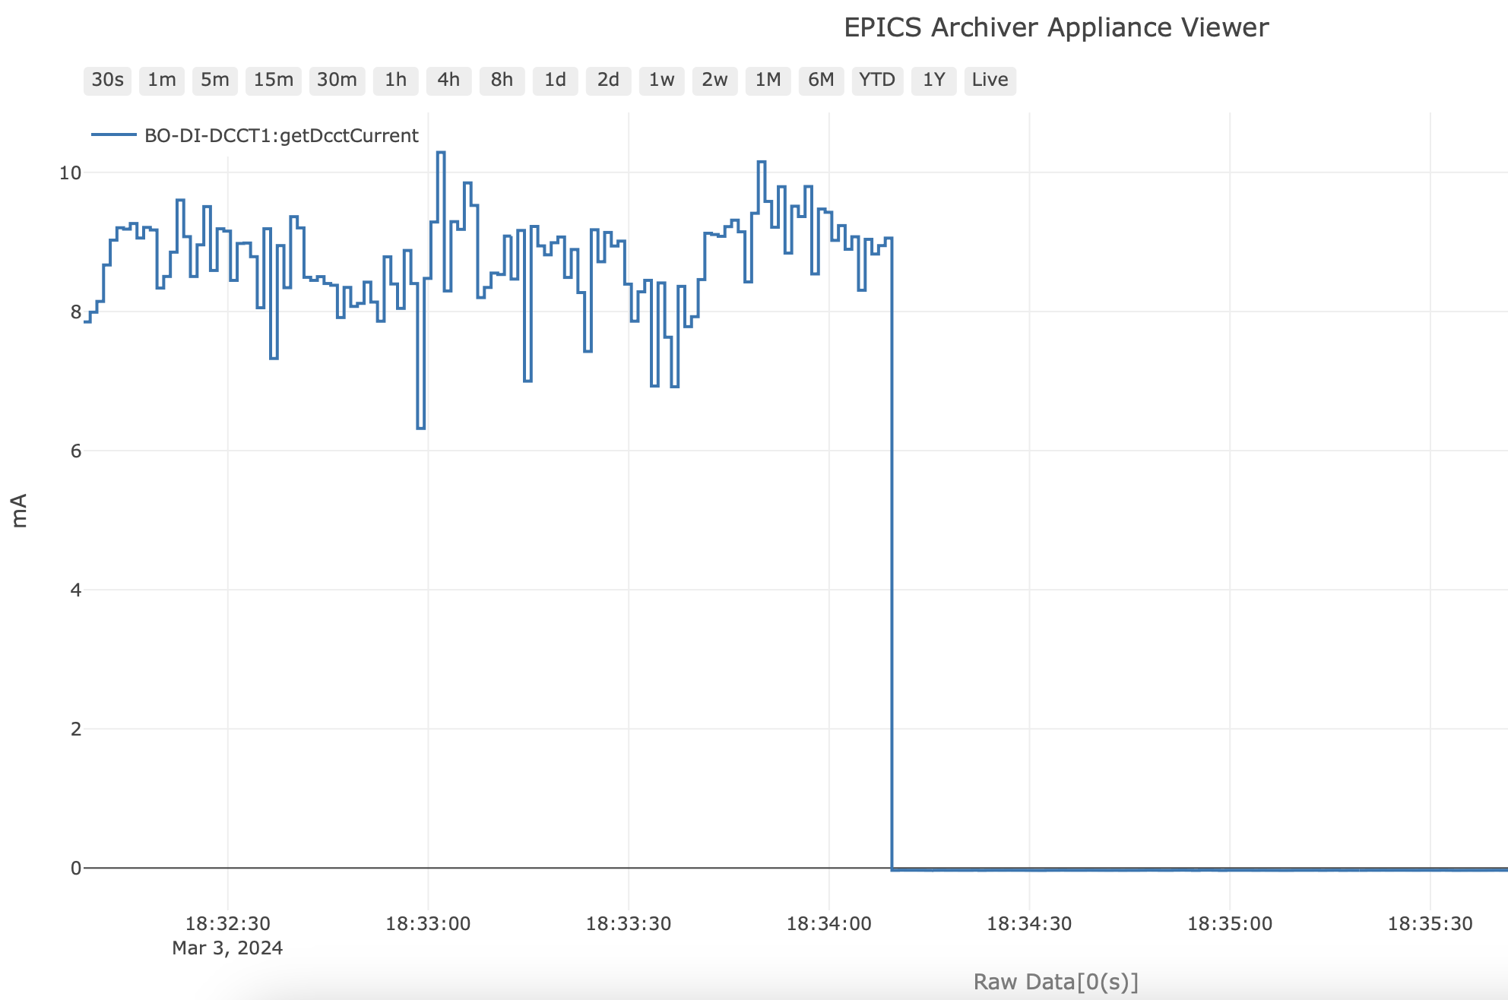

Datamining and AI |How is it being managed currently ??
Machine
1K++ devices
Operators have control and monitor terminals that they use to keep the machine running. If they can find problems before they happen, even just a few minutes before, it can help keep the machines running. But it's really hard to watch for every little thing that could go wrong. Maybe machine learning or deep learning can help with this?
Archiver
EPICS Control System
Elog

Slide 14
Datamining and AI |Topics
Introduction to SESAME Facility
Introduction to the problem
Available resources
Project idea
Similar work done

Slide 15
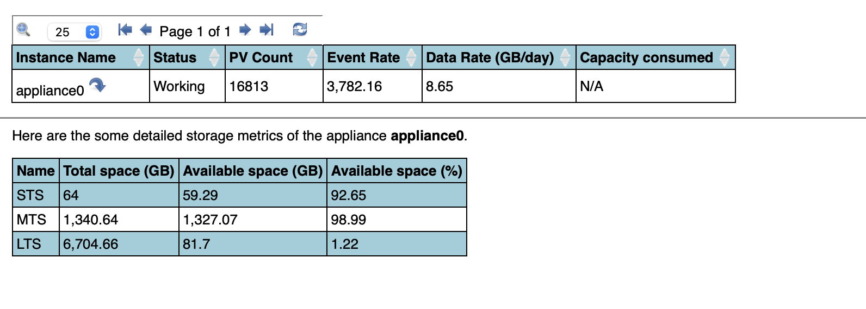
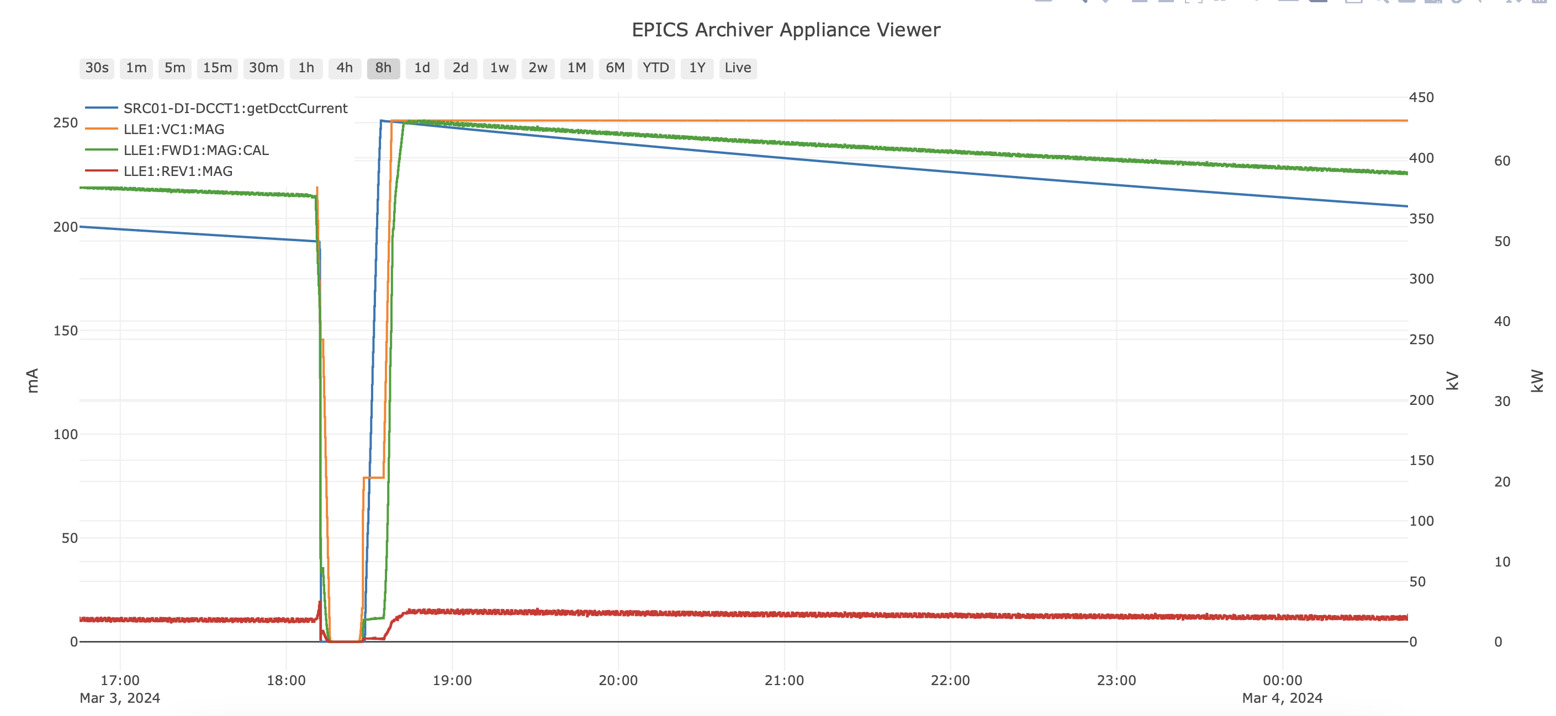
Datamining and AI | Data sources | Archiver

Slide 16
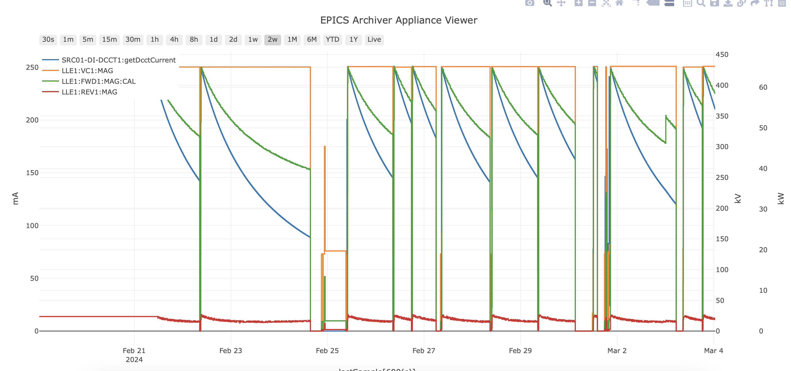
Datamining and AI | Data sources | Archiver

Slide 17
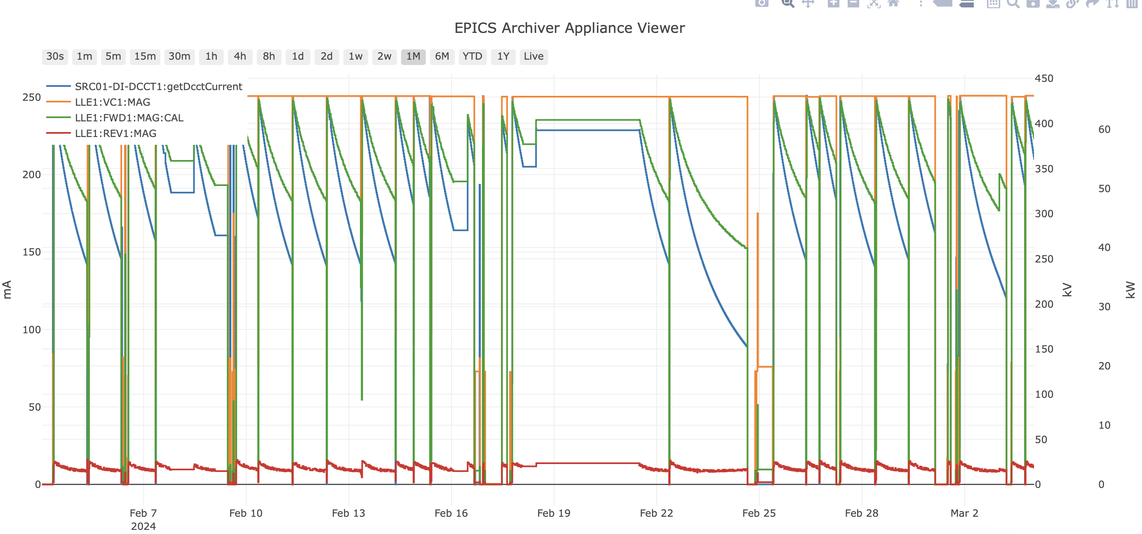
Datamining and AI | Data sources | Archiver

Slide 18
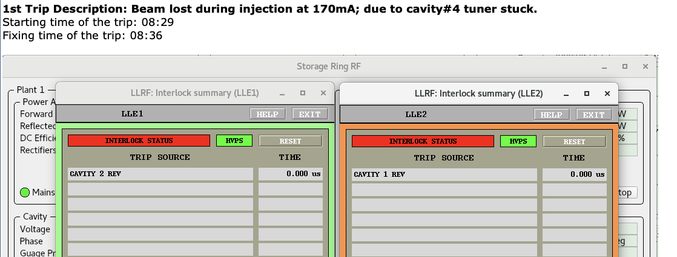
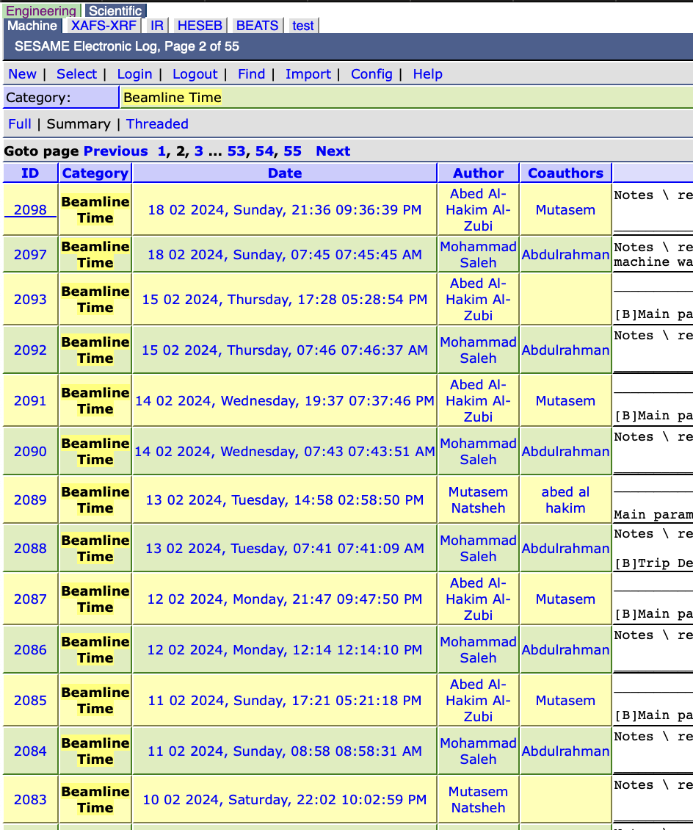
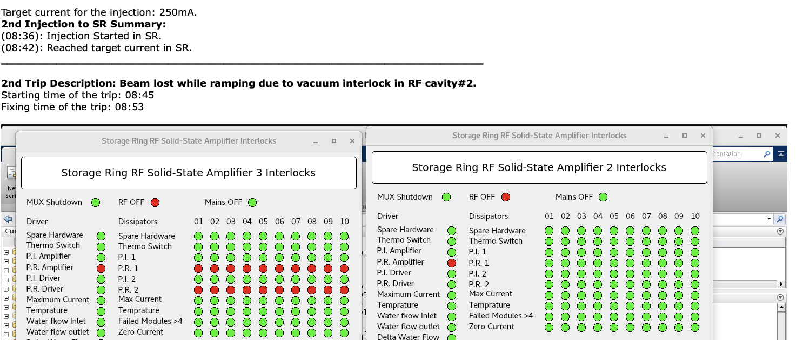
Datamining and AI | Data sources | Elog
Details

Slide 19
Datamining and AI |Topics
Introduction to SESAME Facility
Introduction to the problem
Available resources
Project idea
Similar work done

Slide 20
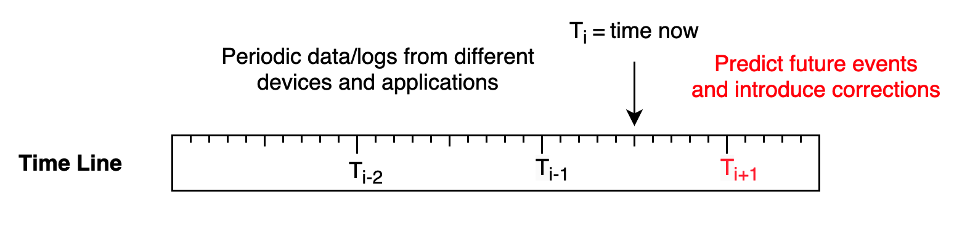
Datamining and AI | Project Idea
Design and implement an advanced and robust DL/ML based module that is able to predict and mitigate machine interruptions in synchrotron facilities in which should enhance users' beamtime and machine performance.
The project is real implementation of data that is collected from Synchrotron-light for Experimental Science and Applications in the Middle East (SESAME) facility.
By using such valuable data, we aim to develop a solution that anticipates potential beam instability and downtimes and also actively works to prevent them.

Slide 21
Datamining and AI |Topics
Introduction to SESAME Facility
Introduction to the problem
Available resources
Project idea
Similar work done

Slide 22
Datamining and AI | Literature review
Reference | Aim | Dataset(s) | Model(s) | Results
JP: A novel approach for classification and forecasting of time series in particle accelerators | Beam interruption prediction | 97 out of 376 PVs were selected through a PV evaluation method | RPCNN and RF | RPCNN model reached an AUC of 0.71 ± 0.01, outperforming the RF model's 0.65 ± 0.01 AUC.
JP: Predicting particle accelerator failures using binary classifiers,” Nuclear Instruments and Methods in Physics Research Section A: Accelerators, Spectrometers, Detectors and Associated Equipment | Beam interruption prediction | The dataset includes 6987 trip-related files and 1699 notrip files, with each pulse represented as a waveform of 120000 data points | RF with techniques like FFT PCA for feature Selection. | RF distinguished normal and pre-failure conditions with precision of 0.84 and recall of 0.57 for NBL, and precision of 0.96 and recall of 0.59 for BL.
JP: Improvements of pre-emptive identification of particle accelerator failures using binary classifiers and dimensionality reduction, | To enhance previous work done “shown above” | Beam pulses from SNS, over 15 days collecting 15,000 waveforms (half good pulses and half bad pulses). | kNN, DT, RF, Gradient Boost, Logistic Regression, NN and LSVM | The Logistic Regression demonstrated the highest performance with a 79.5% accuracy in correctly identifying true negatives (bad pulses). Further refinement of datasets and tuning classifier parameters improved accuracy up to 92% for bad pulse classification.
Machine learning for time series prediction of an accelerator beam to recognize equipment malfunction | Beam interruption prediction | Acquired data from various diagnostics and MPS, including beam current waveforms before, during, and after errant beam pulses. | Employing ML techniques for anomaly detection (kNN, DT, RF, gradient boosts, LSVM, perceptrons, neural networks and logistic regression) then choosing the best to utilize LSTM autoencoders for the prediction of beam loss. | The best classifier was logistic regression with 79.5% precision for true negative prediction. When datasets were filtered and analyzed with LSTM, true negative prediction accuracy reached up to 91.9%, though the false negative rate was around 8%, which was considered too high.

Slide 23
Datamining and AI | Literature review
Reference | Aim | Dataset(s) | Model(s) | Results
Time-series deep learning anomaly detection for particle accelerators, | Anomaly detection and fault prediction in particle accelerators, focusing on RF control system. | 670 million data points, PVs like Lock and Lock Failed statuses, Forward RF power, Tuning motor direction, moving flag, and Cryostat liquid helium tank pressure. | LSTM, TCN and Multi-variable TCN | LSTM: F-score of 0.578, precision of 0.713, and recall of 0.419. TCN: F-score of 0.642, precision of 0.743, and recall of 0.507.Multi-variable TCN: Demonstrated the best results with an F-score of 0.691, precision of 0.831, and recall of 0.516.
JP: Adaptive machine learning for robust diagnostics and control of time-varying particle accelerator components and beams | Predict dynamic changes in system components and beam characteristics. | Simulated a 22-parameter system in LANSCE linear accelerator with a potential of 1022 data points. | The approach termed AML, combines the learning capabilities of ML models like deep neural networks with the robustness of model-independent adaptive feedback control. | The model effectively tracked time-varying beam sizes in real-time, tuning input beam sizes based on end-of-beamline error measurements. It significantly minimized prediction errors compared to non-adaptive methods.
JP: Uncertainty quantification for deep learning in particle accelerator applications, | Evaluate effectiveness of BNNs in estimating predictive uncertainty in particle accelerator applications and benchmark their performance against bootstrapped neural network ensembles. | 3500 instances of beam loss rate measurements, accompanied by the settings for the 13 adjustable skew quadrupoles. 3000 for training, 250 samples each for testing and validation purposes. | BNN and bootstrapped ensembles of neural networks | BNN superior to bootstrapped ensembles in terms of prediction accuracy and uncertainty quantification, for the SPEAR3 ring, BNNs achieved an MAE of 0.055, PICP of 0.81, and MPIW of 0.19. For the LCLS beamline, the BNNs reported an MAE of 0.025, PICP of 0.75, and MPIW of 0.16. In the LCLS-II injector scenario, BNNs reached an MAE of 0.098, with PICP of 0.77 and an MPIW of 0.244,

Slide 24
Datamining and AI |Topics
Introduction to SESAME Facility
Introduction to the problem
Available resources
Project idea
Similar work done
Possible Contributions

Slide 25
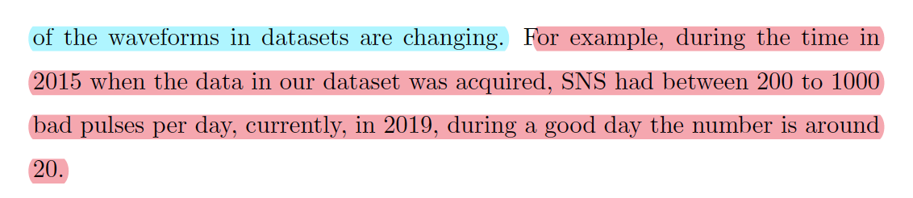
Datamining and AI | Our contribution
All literature were done for top-up injection system, in our case bunch-by-bunch which is more challenging
Real world problem solution – real implementation
ARIMA model can be investigated in our case
RNN can be investigated ??
Sub-system based classifier --- extremely difficult
Super clear and robust data preprocessing
Making dataset available

Slide 26
Datamining and AI |Topics
Introduction to SESAME Facility
Introduction to the problem
Available resources
Project idea
Similar work done
Possible Contributions
Challenges

Slide 27

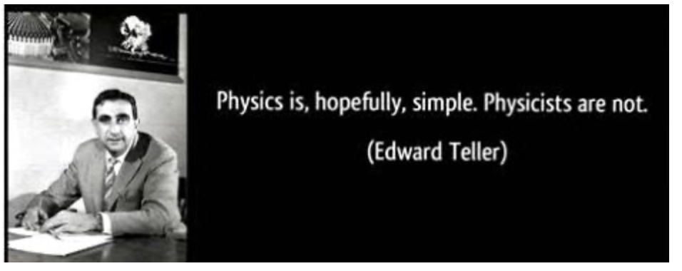
Datamining and AI | Problem Challenges
Dealing with huge amount of data
Finding useful data – domain experts !!
Some data might be not available or noisy
Develop a robust and reliable model otherwise it is just time wasting !!
System should be integrated with domain environment and EPICS control system.
Environment is continuously changing, is it possible to build self adapted system ??
Stand – alone system, zero end-user action.

Slide 28
Datamining and AI |Topics
Introduction to SESAME Facility
Introduction to the problem
Available resources
Project idea
Similar work done
Possible Contributions
Challenges
System architecture and progress description

Slide 29
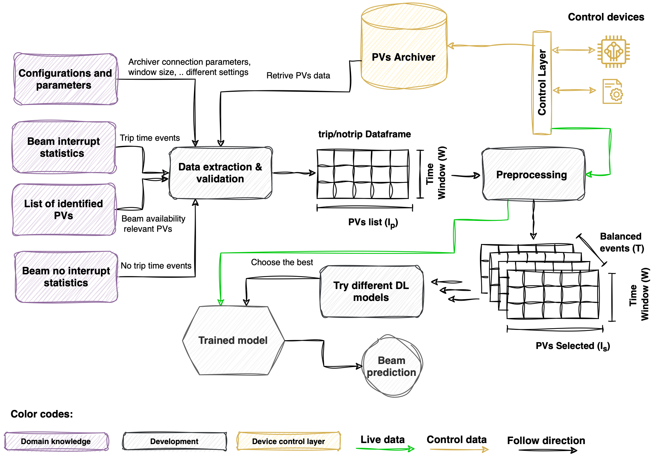
Datamining and AI | System Architecture
Project Phases:
Approval (University & SESAME)
Reading Literature
Domain understanding
Field expert inputs
Data extraction
Data transformation & preprocessing
ML/DL model building
Evaluation
Deployment
Documentation/paper writing (going aligned with steps mentioned above)

Slide 30
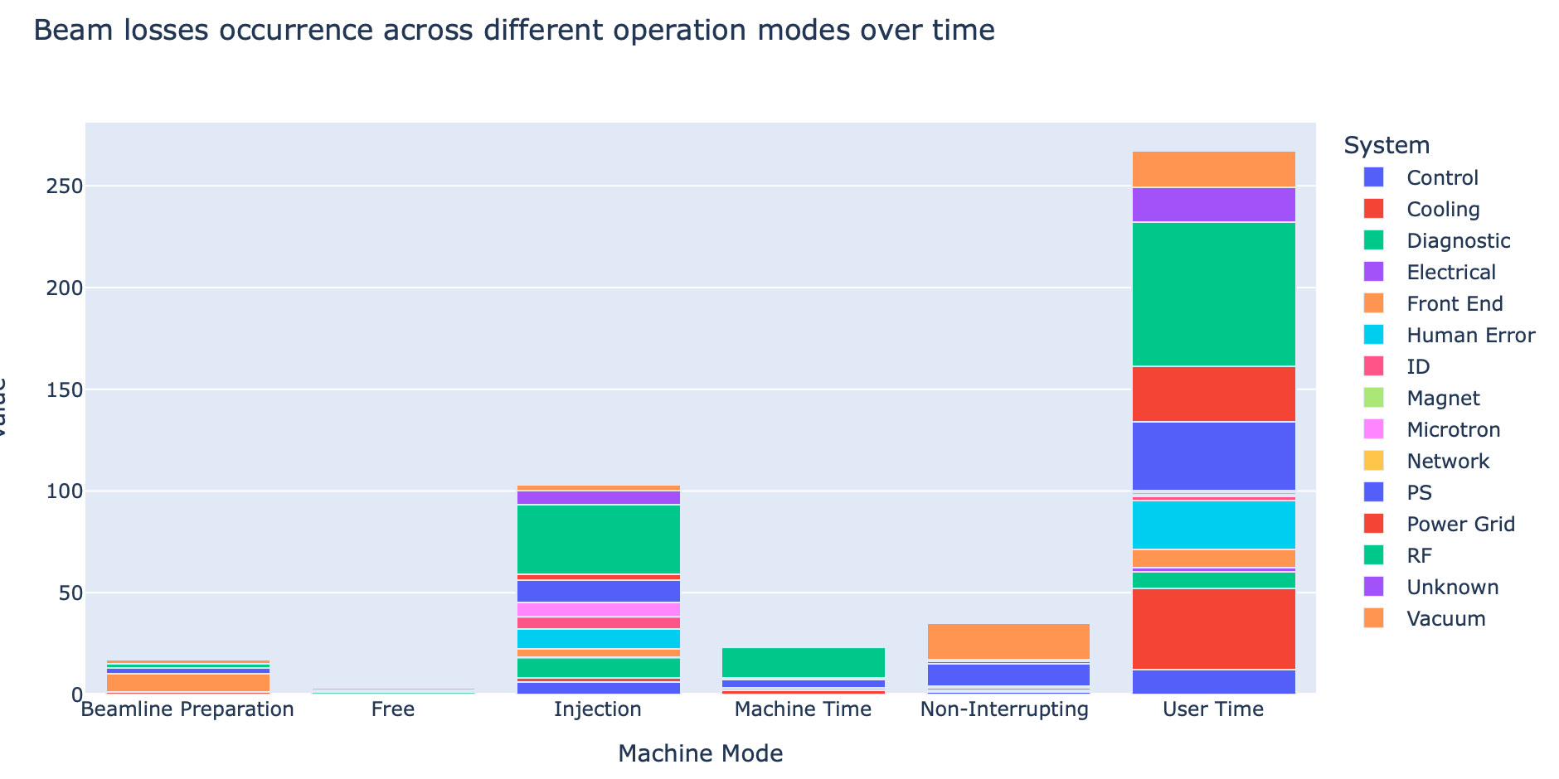
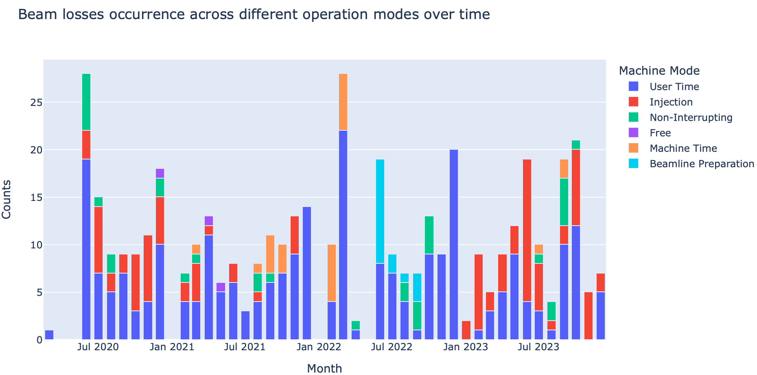
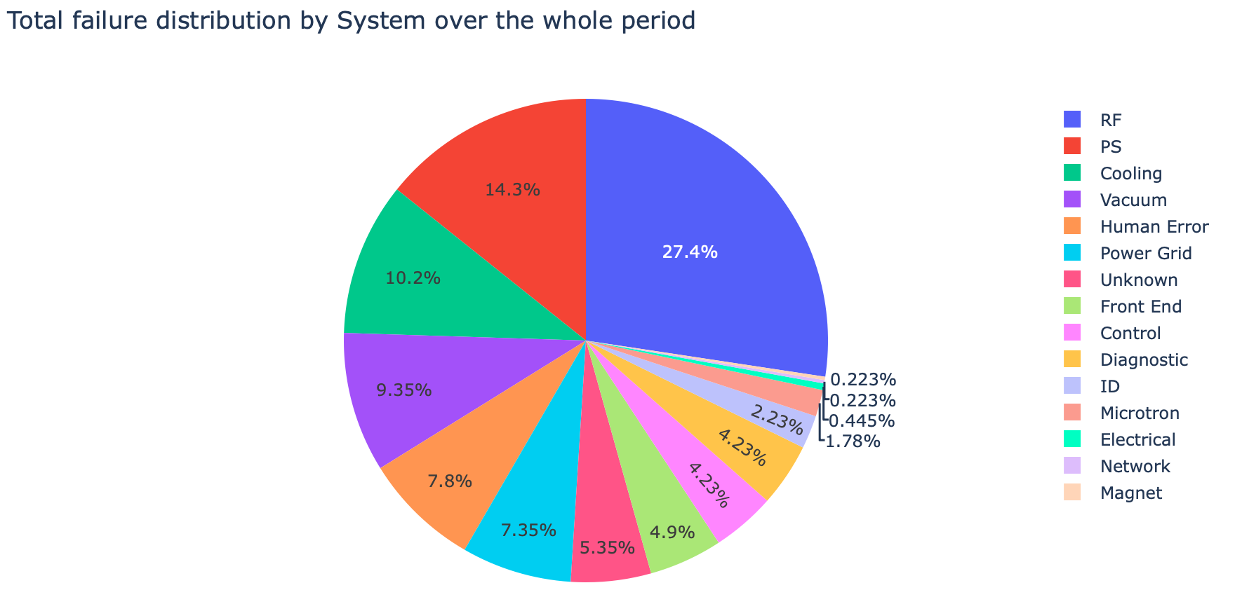
Datamining and AI | System Architecture | Data extraction & validation
Trip events:
450 trip events for the period from March 2020 to December 2023
Trips can be caused by any / many sub-system
Trips recorded across different operation modes
Data Extraction & validation: events analysis -> exclude not relevant events -> exclude unrelated events -> events auto validation -> Data Availability

Slide 31
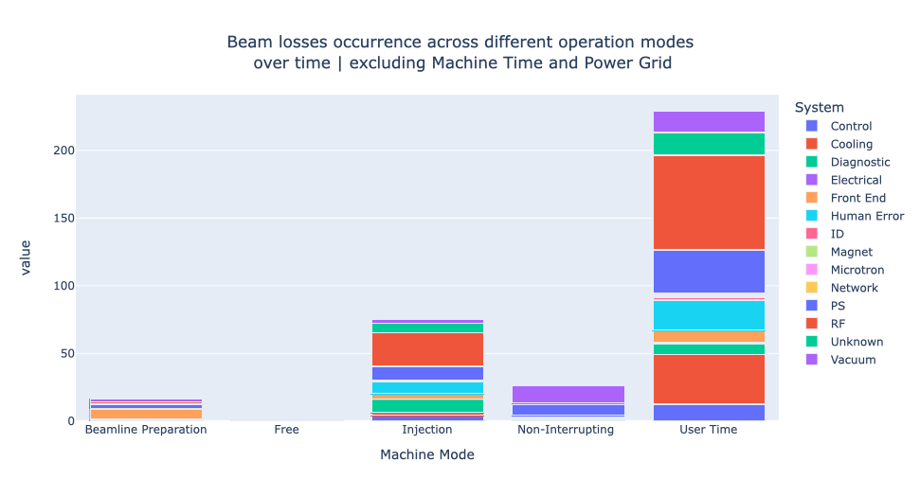
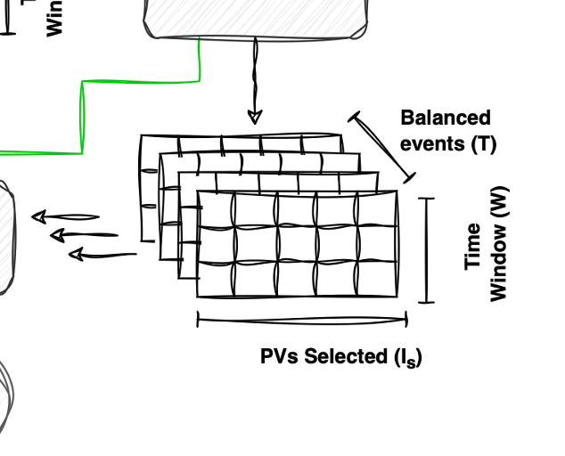
Datamining and AI | System Architecture | Data extraction & validation
Excluding unwanted trip events (not relevant):
Machine time
Power grid issues
Machine Time:
Testing new instruments
Testing software / firmware
HW/SW upgrade
This affects (T)
Data Extraction & validation: events analysis -> exclude not relevant events -> exclude unrelated events -> events auto validation -> Data Availability

Slide 32
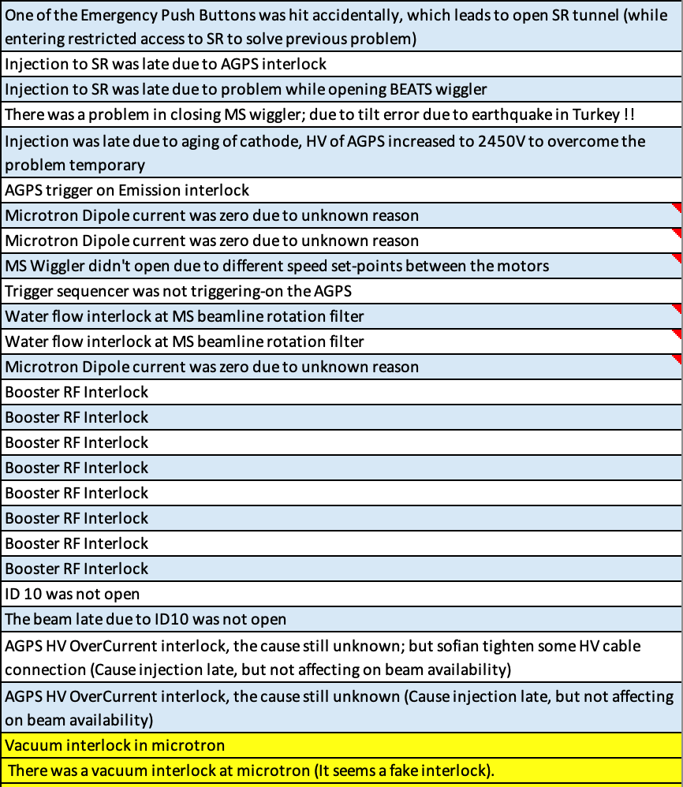
Datamining and AI | System Architecture | Data extraction & validation
Excluding unrelated trip events:
AUX gun
Microtron
Booster
All sub-systems related to the above points
Remember:
3 accelerators Microtron, Booster Ring and Storage Ring.
User beam is only available in Storage Ring (SR).
Beam is kept there long time
Many problems could happen in the other accelerators but not interrupting the beam in SR
This affects (T)
Data Extraction & validation: events analysis -> exclude not relevant events -> exclude unrelated events -> events auto validation -> Data Availability

Slide 33
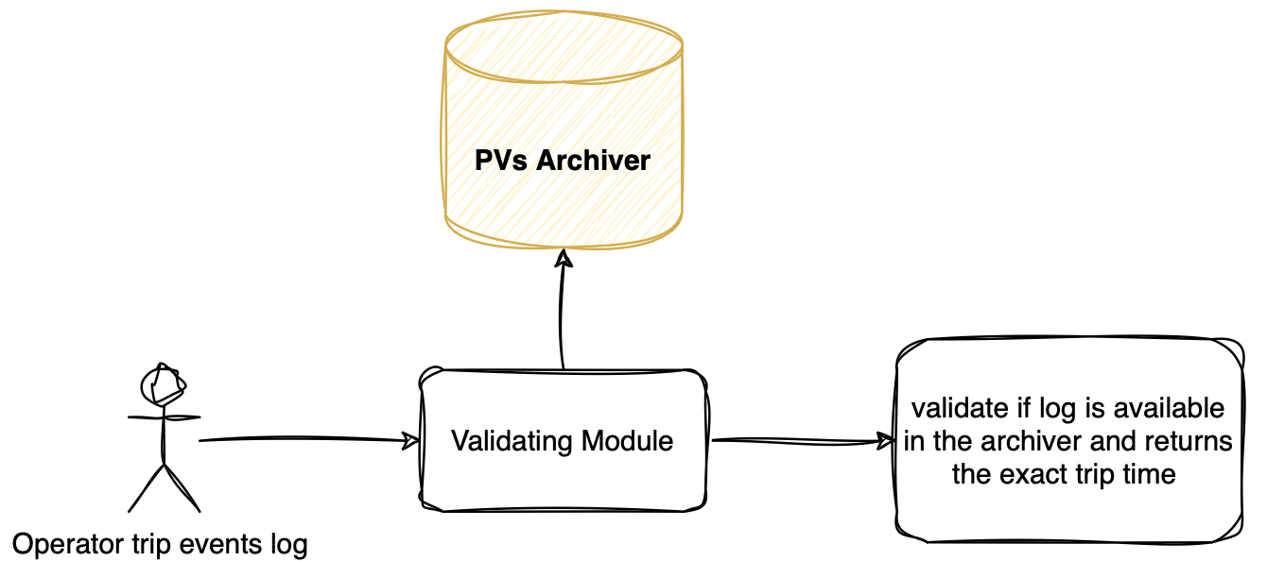
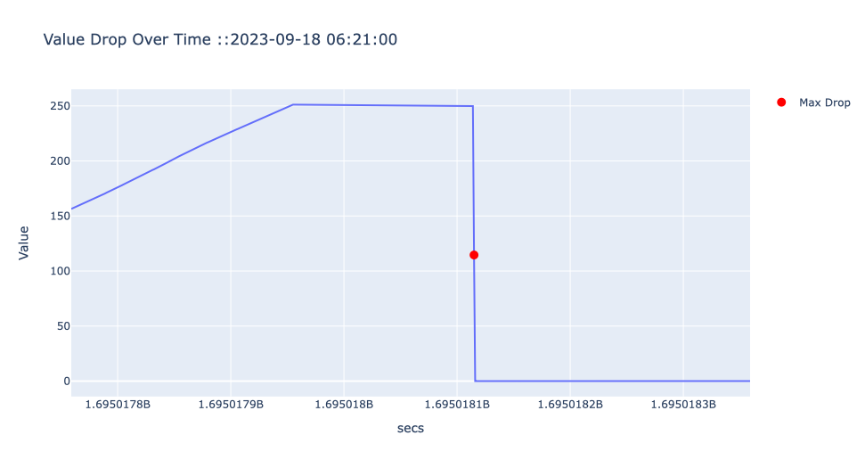
Datamining and AI | System Architecture | Data extraction & validation
Events validation:
A module that validates operator inputs with data recorded at EPICS archiver
Event time: Sep 18, 2023 06:19 as recorded by the operator
Exact time is Sep 18, 2023 06:21
Data Extraction & validation: events analysis -> exclude not relevant events -> exclude unrelated events -> events auto validation -> Data Availability

Slide 34
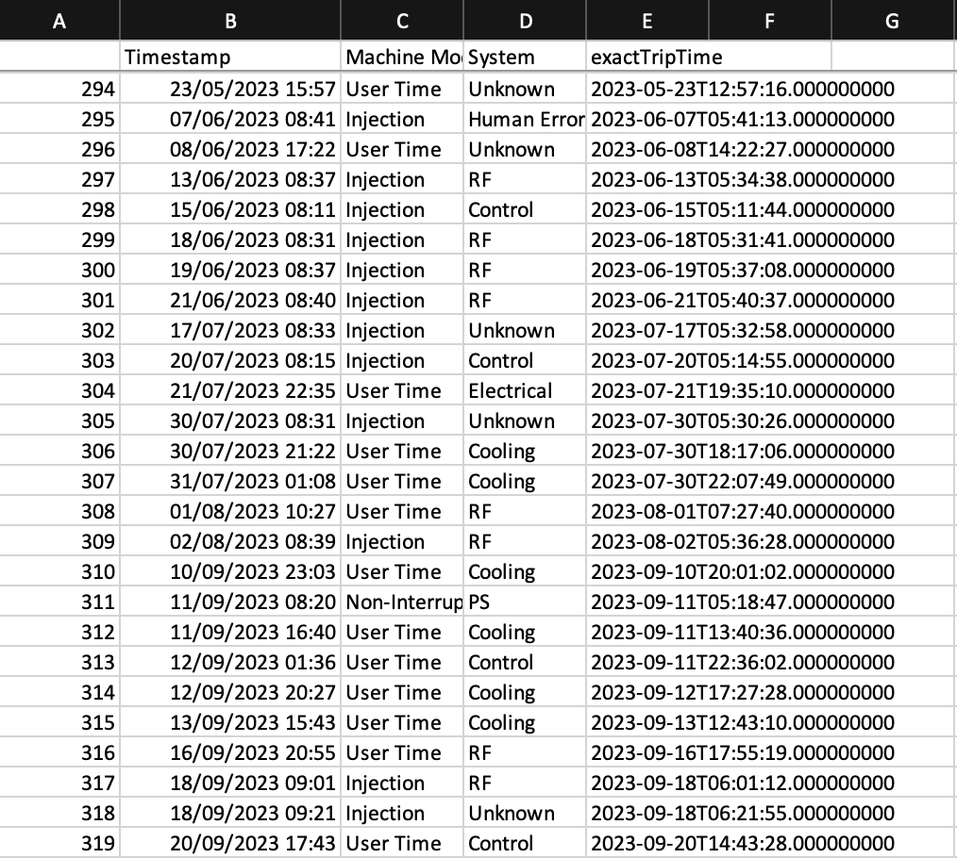
Datamining and AI | System Architecture | Data extraction & validation
Events validation:
File output sample
Data Extraction & validation: events analysis -> exclude not relevant events -> exclude unrelated events -> events auto validation -> Data Availability

Slide 35
Datamining and AI | System Architecture | Data extraction & validation
Data Availability
Year 2020 was not available STS nor LTS of archiver. We have to import them from tapes
No data found in archiver during some trip events -- due to archiver service unavailability, maybe disk failure such records have been removed from the considerations
2022-07-17 06:25:00
2022-10-03 06:15:00
2022-10-30 16:40:00
2022-10-30 17:12:00
2022-10-31 04:44:00
2022-10-31 10:04:00
2022-10-31 11:00:00
2022-12-05 06:56:00
The problems above affect (T)
Data Extraction & validation: events analysis -> exclude not relevant events -> exclude unrelated events -> events auto validation -> Data Availability

Slide 36
Datamining and AI | System Architecture | Data extraction & validation
Trip data enrichment
Some data sets were added manually
These datasets were not recorded as trip events
This positively affects (T)
No trip events:
We can collect as much as we need.
This positively affects (T)
PVs that have been added recently (i.e. in year 2023 only!!)
SRC16-DI-PNHL:getVsize
SRC16-CO-PNHL-THC1:getTemp
SR-DI:getCoupling
I11FE-CO-PHST-THC:GetTemp
I11FE-CO-PSH-THC:GetTemp
This negatively affects (I_{s})
Data Extraction & validation: events analysis -> exclude not relevant events -> exclude unrelated events -> events auto validation -> Data Availability

Slide 37
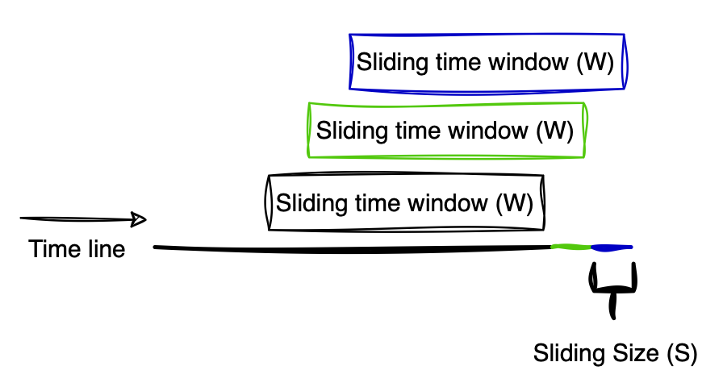
Datamining and AI | System Architecture | Data Preprocessing
Data will be collected in a sliding time window bases
TS | PV₁ | PV₂ | PV₃ | PV₄ | PV_{n}
TS₁ | V_{1,1} | V_{1,2} |  | V_{1,4}
TS₂ | V_{2,1} |  | V_{2,3} | V_{2,4}
TS₃ | V_{3,1} |  |  | V_{3,4}
TS₄ | V_{4,1} | V_{4,2} |  | V_{4,4}
TS₅ | V_{5,1} |  | V_{5,3} | V_{5,4}
TS_{j} | V_{j,1} | V_{j,2} |  | V_{j,4}
 |  |  |  | V_{j+1,4}
 |  |  |  | V_{j+2,4}
 |  |  |  | V_{j+3,4}
 |  |  |  | V_{j+4,4}
 |  |  |  | V_{j+5,4}
 |  |  |  | V_{j+i,4}
Data is imbalanced by it is nature… why ??
Data Preprocessing: Sliding window -> Scanned vs monitored PV

Slide 38
Datamining and AI | System Architecture | Data Preprocessing
Scanned vs monitored PVs
Sliding Size (S)
PV1
Scanned PV @ 6 Hz
PV2
Scanned PV @ 8 Hz
PV3
Scanned PV @ 1 Hz
PV4
Monitored 100 Hz at most
PV5
Monitored 500 Hz at most
W_{i-1}
W_{i}
How to balance the data ?
Data Preprocessing: Sliding window -> Scanned vs monitored PV

Slide 39
MFP | Data extracting and preprocessing
Data balancing – proposed method
Data expansion
Target PV ref.
Desired PV
Desired balanced PV
TS1
V1
TS1
A1
TS2
V2
TS2
V1
TS2
V1
TS3
V3
TS3
A2
A = avg (successful values with time stamps)
TS4
V4
TS4
A2
TS5
V2
A2 = avg (V1, V2)
TS5
V2
A
A
A
TS_{j}
V_{j}
TS_{j}
V3
TS_{j}
A

Slide 40
MFP | Data extracting and preprocessing
Data balancing – proposed method
Data reduction
Target PV ref.
Desired PV
Desired balanced PV
TS1
V1
TS1
V1
TS1
V1
TS2
V2
TS1.1
V2
TS2
V1
TS3
V3
TS1.2
V3
TS3
A2
A = avg (successful values with time stamps)
TS4
V4
TS1.3
V4
TS4
A2
V5
TS5
V2
A2 = avg (V1, V2)
TS1.4
TS1.5
V6
A
TS1.6
V7
A
TS2
V8
A
TS_{j}
V_{j}
TS_{j}
A
TS_{j}
V_{j}

Slide 41
MFP | Data extracting and preprocessing
PVs sampling rate
Archiver vs SCAN

Slide 42
MFP | Data extracting and preprocessing

Slide 43
MFP | Data extracting and preprocessing
Collecting No Trip data
Schedule
Simi random
# of trip events in each year / 4 quarters
In each quarter we select randomly

Slide 44
Thanks
Thanks
Mustafa Alzubi

